Slide 1
Novel Support Vector Machines for Diverse Learning Paradigms
Gabriella Melki, PhD. Candidate, Virginia Commonwealth University
Advisor: Dr. Alberto Cano
Assistant Professor
Virginia Commonwealth University
Advisor: Dr. Sebastián Ventura
Professor
University of Córdoba
Notes:
Thank the committee for being here
Thank others as well
Today I'll present our current work + proposal for future work for my final phd dissertation which is based on developing novel svm…

Slide 2
Motivation
Over the past decade, dataset sizes have grown disproportionately to the speed of processors and memory capacity, limiting machine learning methods to computational time.
More recently, these traditional methods have been extended to accommodate various types of data paradigms:
Multiple-Target Learning
Multiple-Instance Learning
Data Stream Learning
Our contributions aim to deal with these drawbacks that exist in these paradigms using Support Vector Machines.
Notes:
What is the motivation for the line of research?
For traditional machine learning, it stems from the tell-all case of solving large learning problems in a timely fashion
Because dataset sizes have been growing so rapidly, we need to develop machine learning algorithms that are able to extract all the knowledge possible in a timely fashion.
More recently, traditional learning problems and methods have been extended to accommodate various emerging data representations which have given rise to new learning paradigms such as MTL and MIL.
Our contributions aim to tackle these two fundamental problems while remedying the drawbacks of current methods that exist
Before going into details how we tackled these problems, I’d like to provide a brief description of the two paradigms mentioned.

Slide 3
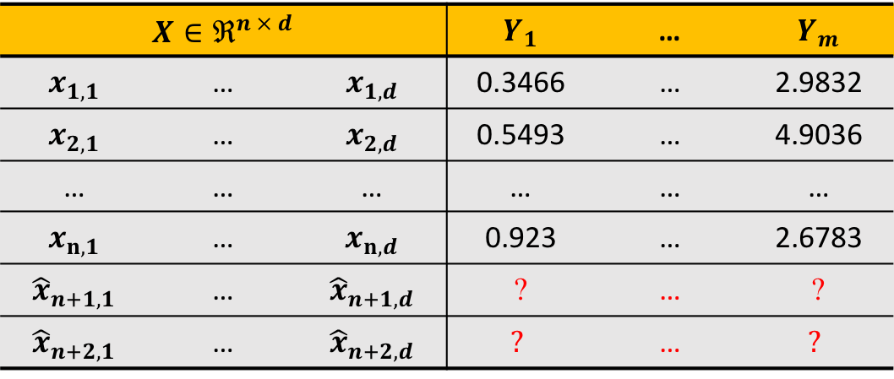
Multiple-Target Learning
The goal: build a model which predicts multiple outputs, or targets, simultaneously.
$$X∈ℜ^{n × d}$$ |  |  | $$Y_{1}$$ | … | $$Y_{m}$$
$$x_{1,1}$$ | … | $$x_{1,d}$$ | 0.3466 | … | 2.9832
$$x_{2,1}$$ | … | $$x_{2,d}$$ | 0.5493 | … | 4.9036
… | … | … | … | … | …
$$x_{n,1}$$ | … | $$x_{n,d}$$ | 0.923 | … | 2.6783
$${\hat{x}}_{n+1,1}$$ | … | $${\hat{x}}_{n+1,d}$$ | ? | … | ?
$${\hat{x}}_{n+2,1}$$ | … | $${\hat{x}}_{n+2,d}$$ | $$?$$ | … | $$?$$
Training
Samples
Unknown
Samples
Inputs
Outputs
Notes:
First, we’ll begin with multiple target learning
Multi-target learning is a challenging task that consists of creating predictive models for problems with multiple outputs
So, each sample is associated with more than a single output, or target (describe the data example)
Since the targets are produced by the same system, this implies that they might be correlated
Many types of multi-target
Multi-label classification
Multi-target regression
For the purpose of this work, we focus on MTR

Slide 4
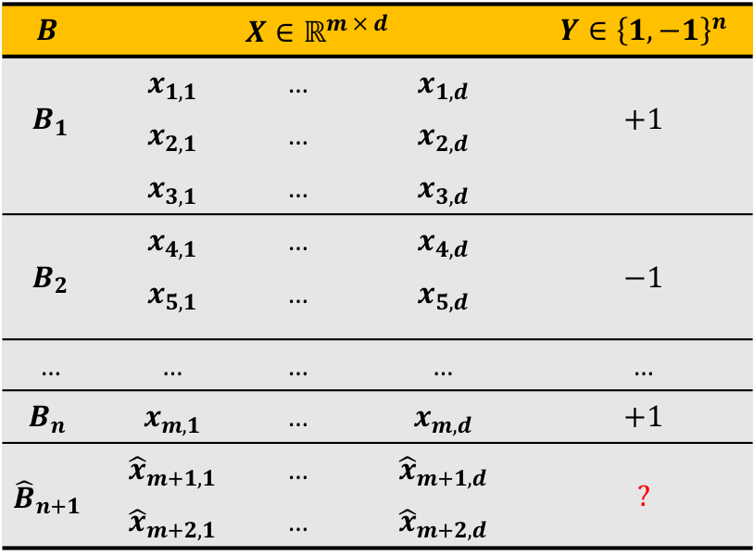
Multiple-Instance Learning
The goal: build a model which, given an unseen Bag containing multiple instances, will predict the bag’s label.
$$B$$ | $$X∈ℝ^{m × d}$$ |  |  | $$Y∈{\left\{1,−1\right\}}^{n}$$
$$B_{1}$$ | $$x_{1,1}$$ | … | $$x_{1,d}$$ | $$+1$$
 | $$x_{2,1}$$ | … | $$x_{2,d}$$
 | $$x_{3,1}$$ | … | $$x_{3,d}$$
$$B_{2}$$ | $$x_{4,1}$$ | … | $$x_{4,d}$$ | $$−1$$
 | $$x_{5,1}$$ | … | $$x_{5,d}$$
… | … | … | … | …
$$B_{n}$$ | $$x_{m,1}$$ | … | $$x_{m,d}$$ | $$+1$$
$${\hat{B}}_{n+1}$$ | $${\hat{x}}_{m+1,1}$$ | … | $${\hat{x}}_{m+1,d}$$ | $$?$$
 | $${\hat{x}}_{m+2,1}$$ | … | $${\hat{x}}_{m+2,d}$$
Training
Bags of instances
Unknown
Bag of instances
Notes:
MIL is a generalization of super...
The instances in the bag are somehow related
We don't know the Individual labels within the bag - this makes it a form of semi-supervised learning
The only label that we know is the bag label - the way this label is assigned is dictated by some MI- Assumption
Describe the data
Given these two learning paradigms, we now move on to our contributions

Slide 5
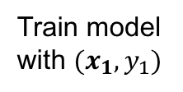
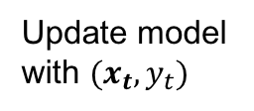
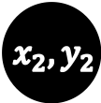
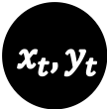
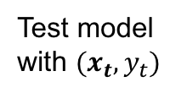
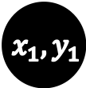
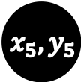
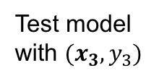
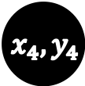
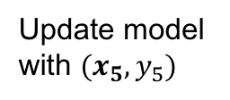
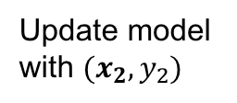
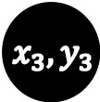
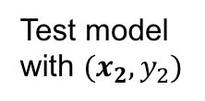
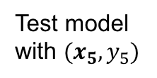
Data Stream Learning
The goal: build a model from continuously and possibly drifting arriving data, which predicts the output of unseen arriving samples.
$${ x}_{1}, y_{1}$$
$${ x}_{2}, y_{2}$$
$${ x}_{3}, y_{3}$$
$${ x}_{4}, y_{4}$$
$${ x}_{5}, y_{5}$$
… …
$${ x}_{t}, y_{t}$$
…
Train model with $(x_{1},y_{1})$
Update model with $(x_{2},y_{2})$
Update model with $(x_{5},y_{5})$
Update model with $(x_{t},y_{t})$
…
…
Test model with $(x_{2},y_{2})$
Test model with $(x_{3},y_{3})$
Test model with $(x_{5},y_{5})$
Test model with $(x_{t},y_{t})$

Slide 6
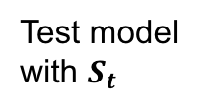
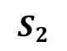
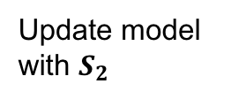
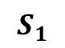
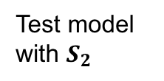
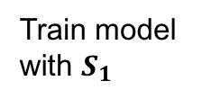
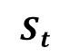
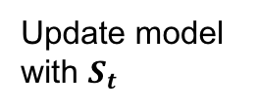
Data Stream Learning
The goal: build a model from continuously and possibly drifting arriving data, which predicts the output of unseen arriving batches.
$$S_{1}$$
$$S_{2}$$
$$S_{t}$$
…
Update model with $S_{2}$
Update model with $S_{t}$
Train model with $S_{1}$
Test model with $S_{2}$
Test model with $S_{t}$

Slide 7
Contributions

Slide 8
Agenda

Slide 9
Support Vector Machines
Classification
Regression
Hinge Loss
Epsilon-Insensitivity Loss
Notes:
Support vector machines (SVM), represent popular linear and non-linear (kernelized) learning algorithms based on the idea of a large-margin classifier.
SVMs are similar to other machine learning techniques, but literature shows that they usually outperform them in terms of scalability, computational efficiency, and robustness against outliers.
They are known for creating sparse and non-linear classifiers, making them suitable for handling large datasets.
The goal of SVC is to learn a classifier f(x), that maximizes the margin of separability between classes while minimizing the loss or error. In this case, the error is the hinge loss function, which is key to the SVMs model sparsity.
[SHOW ANIMATION] The margin is maximized by minimizing the norm of w. This is because the size of the margin is inversely proportional to the norm of w.
Here C controls the tradeoff of margin maximization and error minimization.
REGRESSION
The support vector machine was applied to the regression case, maintaining all the maximal margin algorithmic features.
the goal is to learn a function f(x) with at most ε deviation from the true targets yi for all the training data, while being as flat as possible. This was introduced by Vapnik’s linear loss function with ε-insensitivity zone,
The loss is equal to 0 if the difference between the predicted and true output values is less than ε.
I.E. If the predicted value is within the tube, no loss is incurred
Now that we’ve introduced the SVM classification and regression problems, this brings us to how to solve them.

Slide 10
Using Kernels
To handle cases where data are non-linearly separable, while enhancing the classifiers capabilities, a kernel function can be used:
The advantage of utilizing kernels is being able to calculate the inner product in the input space rather than in the very high feature dimensional space.
Notes:
The SVM problem can kernelized to account for non-linearly separable data by using a kernel function where the feature space is mapped to a higher dimensional space,
Here, φ(·) represents that mapping function
The advantage of utilizing kernels is being able to calculate the inner product in the input space rather than in the very high feature dimensional space
The SVM model output, o, for a given input vector x is defined by the kernel, is given by.. where α are the coefficients, or weights, of the expansion in feature space, and b ∈ R is the so-called bias term.
A model is called dense if the absolute value of all its weights are greater than 0, while a sparse model would be one that contains some αi = 0. The level of sparseness may vary, but the sparser the model, the more scalable the applications.

Slide 11
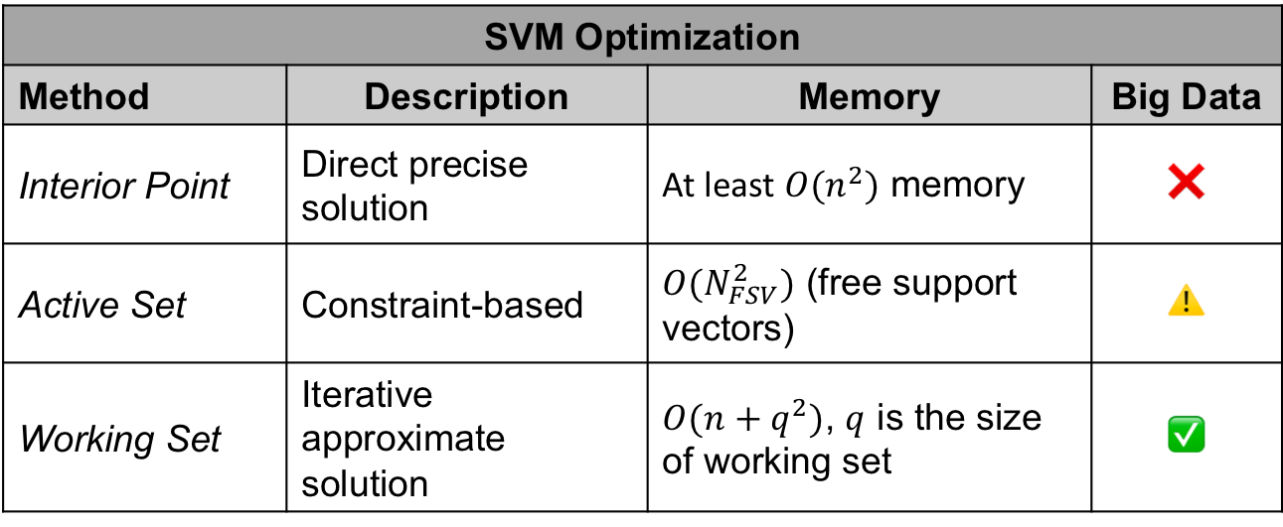
Solving the SVM Problem
SVM Optimization
Method | Description | Memory | Big Data
Interior Point | Direct precise solution | At least $O(n^{2})$ memory | ❌
Active Set | Constraint-based | $O(N_{FSV}^{2})$ (free support vectors) | ⚠️
Working Set | Iterative approximate solution | $O(n+q^{2})$, $q$ is the size of working set | ✅
Notes:
Although support vector machines represent a major development in machine learning algorithms, in the case of large-scale problems (hundreds of thousands to several millions of samples), the design of SVM training algorithms still has room for improvement.
Traditional QP solvers can be used but they explode with the number of samples
SMO is by far the most popular and widely used method for solving both classification and regression, but it is highly dependent on the SVM hyperparameters.
Geometric solvers include, such as MN-SVM, BVM, and CVM, however MNSVM has been shown to outperform the popular BVM, CVM, and SMO methods.
More recently, descent methods (coordinate or stochastic) have been used because of their sub-linear convergence.
Given these popular solvers, we opted to take the SVM and apply it to the emerging learning paradigms mentioned previously.

Slide 12
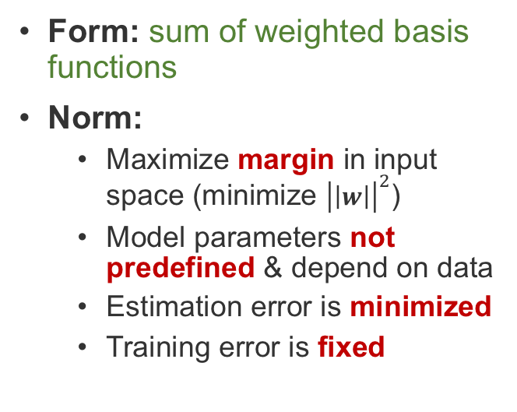
Why SVMs: Form vs. Norm
Statistical Inference (e.g. NN)
Support Vector Machines
Form: sum of weighted basis functions
Norm:
Minimize sum of errors squared in output space
Model parameters predefined before training
Estimation error remains fixed
Training error is minimized
Form: sum of weighted basis functions
Norm:
Maximize margin in input space (minimize ${\left|\left|w\right|\right|}^{2}$)
Model parameters not predefined & depend on data
Estimation error is minimized
Training error is fixed

Slide 13
Multi-Target SVR using Maximum Correlation Chains
Notes:
Now, we will present our 3 contributions for the multi-target regression learning paradigm based on the idea of building chained regressors.
First, I'll give a brief background on some methods for solving this paradigm, then we will dive into the technicalities of my proposals
G. Melki et al. “Multi-target support vector regression via correlation regressor chains”. Information Sciences, vol. 415, pp. 53–69, 2017.

Slide 14
Multi-Target Regression
Approach | Methods | Targets’ Relationships Exploited | Run Time | Accuracy
Problem Transformation | Single Target | ❌ | ⚠️ | ✅
 | MTR Stacking | ⚠️ | ⚠️ | ⚠️
 | Regressor Chains | ⚠️ | ⚠️ | ⚠️
Algorithm Adaptation | Statistical methods | ✅ | ⚠️ | ⚠️
 | Kernel methods | ✅ | ✅ | ⚠️
 | MTR Trees | ✅ | ✅ | ✅
✅ - good performance
⚠️ - dependent on # of targets & their correlations (if exist)
❌ - poor performance
Notes:
There are two main approaches to multi-target learning, problem transformation and algorithm adaptation.
Problem transformation methods involve altering the MT problem into ST ones.
Algorithm adaptation methods involve modifying existing traditional algorithms to predict all the target variables simultaneously.
It is known that algorithm adaptation methods outperform problem transformation methods. The most valuable advantage of using AA is that, not only are the relationships between the sample variables and the targets exploited, but the relationships between the targets amongst themselves are as well.
One approach for AA in the context of classification are the idea of classifier chains
Examples of these include...
Chaining usually involve 2 stages:
Building an ST model
Using knowledge gained by first step to predict remaining targets, while using correlations.
We decided to utilize this chaining idea and apply it to regression using SVRs
Although these methods seem similar in nature, there are fundamental differences

Slide 15
Base-Line Multi-Target SVR
Notes:
The base model is the SVR model, where m single-target non-linear support vector regressors (NL-SVR) are built for each target variable Yj
Describe figure
The reason behind this method:
Evaluate the performance of ST-SVM against the other SOA methods
Evaluate it as a base-line method for the purpose of observing the improvements of our chained methods against a ST method

Slide 16
SVR with Random Chains (SVRRC)
Notes:
This brings us to our second contribution, inspired by ERCC, SVRRC.
Describe
Here the dataset is not split, but rather the model is adapted to the various target outputs
The adaptation stems from model chaining
So, what constitutes building a chained model?
Describe using the figure
[Difference between us and ERCC]
In ERCC, their chained model consists of chaining the predicted target values from the previous step, for SVRRC, we opted against that and used the true target outputs in order to minimize error propagation during the chaining process
This method was fine, but we worried that that randomly generated chains might not maximally capture the target’s correlations. That brings us to our next proposal.
4 targets > 10 chains

Slide 17
SVR max-Correlation Chain (SVRCC)
Notes:
This contribution builds a single chained regressor in the direction of maximum correlation among the target variables
The idea behind this is to build a single chain that captures the targets correlations properly
This ensures that using the target as input for the next positively contributes towards learning
We first calculate the correlation coefficient matrix for the target variables,
take the row-wise sum of absolute value,
sort them in decreasing order, and
use the indices as the max-corr chain

Slide 18
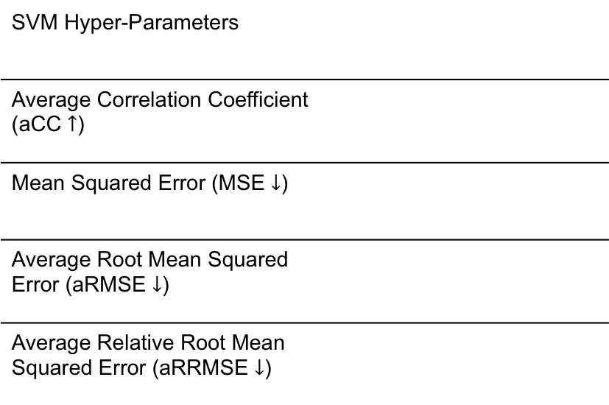
Experimental Environment
SVM Hyper-Parameters
Average Correlation Coefficient (aCC $↑$)
Mean Squared Error (MSE $↓$)
Average Root Mean Squared Error (aRMSE $↓$)
Average Relative Root Mean Squared Error (aRRMSE $↓$)
Notes:
Algorithm comparison with the popular methods mentioned previously because framework is readily available: RC, ST, MTS, MTSC, ERC, ERCC, and MORF
Developed our novel SVRs in MULAN’s framework of MTRgressor, which was built on top of weka. and used the recommended parameters for each of the methods compared
The following are the metrics used
rigorous statistical analysis was performed as well but for the sake of time, we will only report the bonf-dunn with critical difference value with 95% confidence
The ST base-line model used was Bagging of 100 regression trees.
The MTSC and ERCC methods are run using 10-fold cross-validation, and the ensemble size for the ERC and ERCC methods was set to 10.
The ensemble size of 100 trees was used for MORF, and the rest of its parameters were set as recommended by Kocev et al. “Tree ensembles for predicting structured outputs”. In: Pattern Recognition 43 (2013), pp. 817–833.

Slide 19
Results
Notes:
All proposals 17 out of the 24 datasets
SVR performs the best on 1 / 17
SVRRC 5 / 17
SVRCC performs the best on 11 / 17
These results complement our initial hypothesis that chaining does in fact improve the performance of the classifier

Slide 20
Results
Notes:
Here the results indicate that the ST methods are the fastest, which makes sense because they are neither ensembles nor chained classifiers.
Talk about how SVRCC is competitive against the ST methods
Not only is it competitive in terms of performance, but it is also competitive in terms of time

Slide 21
Multi-Target Regression Conclusions
SVR – Results show SVR’s superior performance as a base-line model, rather than regression trees, as used in MORF.
SVRRC – Results highlighted the importance exploiting relationships among the target variables during training.
SVRCC – Results show it’s superiority:
Ranked the first in all quality metrics & second best in terms of run time.
SVRCC performed better than SVR & SVRRC
This shows that the targets’ maximum correlation does positively contribute toward model training

Slide 22
Multi-Instance SVM using Bag Representatives
Notes:
Now I would like to present our contribution towards the Multiple-Instance learning paradigm, a MI SVM for classification using bad-representatives
G. Melki et al. “MIRSVM: Multi-Instance Support Vector Machine with Bag Representatives”. Pattern Recognition, vol. 79, 228-241, 2018.

Slide 23
Multi-Instance Classification
Paradigms
Instance Space
Bag Space
Embedded Space
Collective assumption
Standard MI assumption
Distance between bags
Vocabulary based
Not Vocabulary based
✅ bags contain large number of instances
❌ bags contain several classes of instances
❌ bags contain large number of instances
✅ bags contain several classes of instances
Notes:
As mentioned previously, MIL is the learning paradigm where samples are considered bags, which contain multiple instances, and each bag is associated with a label.
This bag-level label is assigned by some MI assumptions, and the one that is within the scope of this work is the SMI.
The SMI Assumption states that…
There are several approaches to solving the MIL problem, two of those include the Instance level paradigm and bag level paradigm.
Instance level paradigm: aim to separate instances in positive bags from those in negative ones
Bag level paradigm: treat each bag as a whole entity, implicitly extracting information from each bag in order to accurately predict their labels
For our approach, we were inspired by MISVM, proposed by Andrews et. al.
It is a mixed-integer quadratic program that solves the MI problem at an instance-level, using a support vector machine, & is solved heuristically.
It tries to identify the key instance from each positive bag that makes the bag positive by assuming it has the highest margin value.
Instances from positive bags are selected as bag-representatives, and the algorithm iteratively creates a classifier that separates those representatives from all instances from the negative bags.
A disadvantage of this approach stems from the assumption that all instances within positive bags are also positive, which is an implicit step in the initialization of MISVM as well as its subsequent iterations.
The way we aimed to remedy this class imbalance problem is to restrict the instances in the negative class as well.

Slide 24
Multi-Instance Classification
Paradigms
Instance Space
Bag Space
Embedded Space
Collective assumption
Standard MI assumption
Distance between bags
Vocabulary based
Not Vocabulary based
✅ bags contain large number of instances
❌ bags contain several classes of instances
❌ bags contain large number of instances
✅ bags contain several classes of instances
Notes:
As mentioned previously, MIL is the learning paradigm where samples are considered bags, which contain multiple instances, and each bag is associated with a label.
This bag-level label is assigned by some MI assumptions, and the one that is within the scope of this work is the SMI.
The SMI Assumption states that…
There are several approaches to solving the MIL problem, two of those include the Instance level paradigm and bag level paradigm.
Instance level paradigm: aim to separate instances in positive bags from those in negative ones
Bag level paradigm: treat each bag as a whole entity, implicitly extracting information from each bag in order to accurately predict their labels
For our approach, we were inspired by MISVM, proposed by Andrews et. al.
It is a mixed-integer quadratic program that solves the MI problem at an instance-level, using a support vector machine, & is solved heuristically.
It tries to identify the key instance from each positive bag that makes the bag positive by assuming it has the highest margin value.
Instances from positive bags are selected as bag-representatives, and the algorithm iteratively creates a classifier that separates those representatives from all instances from the negative bags.
A disadvantage of this approach stems from the assumption that all instances within positive bags are also positive, which is an implicit step in the initialization of MISVM as well as its subsequent iterations.
The way we aimed to remedy this class imbalance problem is to restrict the instances in the negative class as well.

Slide 25
Multi-Instance Classification
Paradigms
Inspired by MI-SVM (Andrews et. al.)
Mixed-integer QP problem
Solved heuristically using positive bag-representatives
✅ When positive bags contain a sparse number of positive instances
❌ Class imbalance with representatives
Instance Space
Bag Space
Embedded Space
Collective assumption
Standard MI assumption
Distance between bags
Vocabulary based
Not Vocabulary based
✅ bags contain large number of instances
❌ bags of different classes contain similar instances
❌ bags contain large number of instances
✅ bags contain several classes of instances
Notes:
As mentioned previously, MIL is the learning paradigm where samples are considered bags, which contain multiple instances, and each bag is associated with a label.
This bag-level label is assigned by some MI assumptions, and the one that is within the scope of this work is the SMI.
The SMI Assumption states that…
There are several approaches to solving the MIL problem, two of those include the Instance level paradigm and bag level paradigm.
Instance level paradigm: aim to separate instances in positive bags from those in negative ones
Bag level paradigm: treat each bag as a whole entity, implicitly extracting information from each bag in order to accurately predict their labels
For our approach, we were inspired by MISVM, proposed by Andrews et. al.
It is a mixed-integer quadratic program that solves the MI problem at an instance-level, using a support vector machine, & is solved heuristically.
It tries to identify the key instance from each positive bag that makes the bag positive by assuming it has the highest margin value.
Instances from positive bags are selected as bag-representatives, and the algorithm iteratively creates a classifier that separates those representatives from all instances from the negative bags.
A disadvantage of this approach stems from the assumption that all instances within positive bags are also positive, which is an implicit step in the initialization of MISVM as well as its subsequent iterations.
The way we aimed to remedy this class imbalance problem is to restrict the instances in the negative class as well.

Slide 26

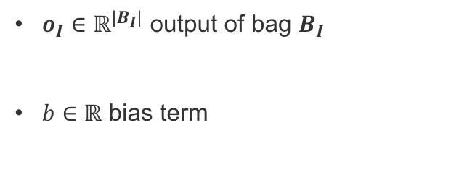
MIRSVM: Formulations
Primal
Dual
$S$ vector of bag representative indices
$x_{S_{I}}$ representative instance of bag $B_{I}$
$o_{I}∈ℝ^{|B_{I}|}$ output of bag $B_{I}$
$b∈ℝ$ bias term
G. Melki et al. “MIRSVM: Multi-Instance Support Vector Machine with Bag Representatives”. Pattern Recognition, vol. 79, 228-241, 2018
Notes:
MIRSVM is based on the idea of selecting representative instances from both positive and negative bags which are used to find an unbiased, optimal separating hyperplane.
What we did was first reformulate the L1-SVM problem to optimize over bags rather than instances, as shown
A representative is iteratively chosen from each bag, and a new hyperplane is formed according to these new selected representatives until they converge.
Based on the SMI hypothesis, only one instance in a bag is required to be positive for the bag to adopt a positive label.
In other words, the most positive instance is chosen from each positive bag and the least negative instance is chosen from each negative bag (instances with the largest output value based on the current hyperplane)
These representatives are stored in SI
xsi ...
what we opted to derive and solve the dual problem using a QP solver
the following equations represent the calculation for the output and bias terms for the dual

Slide 27
MIRSVM: Algorithm
Notes:
First we initialize the representatives randomly
then...

Slide 28
Comparison of MIRSVM and MISVM
Notes:
Here we have 2 comparison plots of the decision boundaries produced by MISVM and our MIRSVM on a toy dataset. The two methods were built on the same SVM hyper parameters.
From this plot, we can see the major differences in the final models. This is because of a couple of major differences.
Unlike MISVM, MIRSVM is designed to utilize and select representatives from positive and negative bags
MISVM allows multiple representatives to be chosen from negative bags and limits positive bag-representatives to be one, while MIRSVM allows for balanced bag-representative selection, where each bag is allowed one.
MISVM also uses a wrapper method to initialize the positive bag-representatives by taking the mean vector of the instances within each positive bag. This is an implicit assumption that the instances within the positive bags are all positive, whereas MIRSVM’s initialization procedure selects an instance from all bags at random, ensuring no noise is added by any wrapper techniques during initialization and no assumptions are made about the instances.
Due to the constraints on the representatives, MIRSVM produces sparser models while MISVM has the freedom to select as many negative support vectors as it needs and restricts the support vectors chosen from positive bags to be one.

Slide 29
Experimental Environment
SVM Hyper-Parameters
Accuracy
Precision
Recall
Cohen’s Kappa Rate
Area Under ROC Curve
Notes:
The main aim of the experiments is to compare our contribution to other multi-instance support vector machines, contemporary multi-instance learners, and ensemble methods.
Datasets from Weka1 [38] and KEEL2 [2] dataset repositories.
Instance-level methods include MIOptimalBall, MIBoost, MISVM, MIDD, and MIWrapper.
Bag-level methods include MISMO, SimpleMI, miGraph, and TLC.
The ensemble-based bag-space methods, Bagging and Stacking, were also used.
These algorithms were chosen because they have shown considerable performance in learning multi-instance models, while also having their frameworks readily available for reproducing their results through MILK, the Multi-Instance Learning Kit, used in conjunction with the Weka framework.

Slide 30
Results
Notes:
Bag-based and ensemble learners perform better than the instance-based and wrapper methods
MIRSVM performs better than MISVM for all datasets, indicating that using representatives from each bag and limiting the number of support vectors per negative bag improves the classification performance.
Instance-level classifiers and wrapper methods, such as MIBoost, MIWrapper, and SimpleMI perform the worst, This behavior emphasizes the importance of not making prior assumptions about the positive bags’ distributions.

Slide 31
Results
Notes:
MIRSVM has the fastest run time and is ranked second.
MIRSVM shows very good scalability considering the number of features, such as in the webmining dataset which comprises of 5863 attributes.
It is important to note that quadratic programming solvers are not the most efficient tools for solving optimization problems in terms of run time, and yet MIRSVM still is shown to perform competitively against the current widely used algorithms. The scalability of MIRSVM is founded on the speedy rate of bag-representative convergence. This is shown in Figure 4.2 in my proposal document.
SimpleMI achieves the highest rank and competitive run times because, rather than use the instances in each bag to train a model, it takes the mean value of the instances in a bag and uses that for training. Even though SimpleMI has fast run-times, its performance over the previous metrics has been shown to be random and not as effective as the bag-level methods.

Slide 32
Multi-Instance Classification Conclusions
The experimental study showed the better performance of MIRSVM compared with existing multi-instance support vector machines, traditional multi-instance learners, as well as ensemble methods.
The results were compared and further validated using statistical analysis:
bag-level based and ensemble learners had the best performance
instance-level based learners performed poorly in comparison or were deemed as strongly biased and unstable classifiers
MIRSVM performs statistically better, neither compromising accuracy nor run time while displaying a robust performance across all datasets.

Slide 33
Online SVM using Worst-Violators
G. Melki et al. “OLLAWV: OnLine Learning Algorithm using Worst-Violators”. Applied Soft Computing, vol. 66, 384-393, 2018

Slide 34
Online Learning
Primal Optimization
Linked to the perceptron algorithm
Advantages
Disadvantages
✅ Simple implementation
✅ Computationally efficient when reaching predefined risk
❌ No meaningful stopping criterion
❌ Computationally complex when number of samples too large
G. Melki et al. “OLLAWV: OnLine Learning Algorithm using Worst-Violators”. Applied Soft Computing, vol. 66, 384-393, 2018

Slide 35
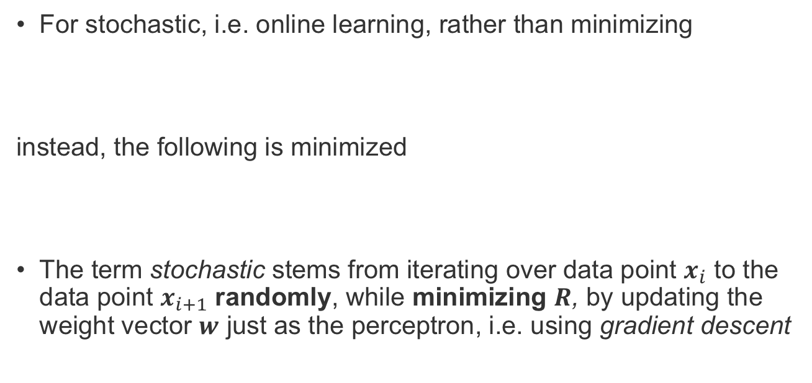
Online Learning
For stochastic, i.e. online learning, rather than minimizing
instead, the following is minimized
The term stochastic stems from iterating over data point $x_{i}$ to the data point $x_{i+1}$ randomly, while minimizing $R$, by updating the weight vector $w$ just as the perceptron, i.e. using gradient descent
G. Melki et al. “OLLAWV: OnLine Learning Algorithm using Worst-Violators”. Applied Soft Computing, vol. 66, 384-393, 2018
Notes:
SVMs were typically treated and solved as a constrained quadratic optimization in dual space. Their early development was hindered because of the quadratic dependence on the number of samples and of the memory required to efficiently solve them. This led to the idea of optimizing over subsets of the data, also known as decomposition methods.
Although these methods improved convergence rates, in practice, their superlinear (and sometimes cubic) dependence on the number of samples still was an issue in terms of slow run times when learning from massive datasets. Linear SVMs, taking advantage of linear kernels, were shown to outperform decomposition SVMs, motivating research for solving the SVM problem in the primal. It has been shown that when finding an approximate solution, primal optimization is superior.
These algorithms for the linear SVM are mostly based on the perceptron - the simplest stochastic learning algorithm for binary linear classification in the primal space. The perceptron cycles repeatedly, one sample at a time, updating the weight vector accordingly, until an appropriate condition is satisfied. By updating cyclically, these types of algorithms are able to process large amounts of data at a much faster speeds with low memory resources, consequently making them suitable for handling large datasets.
An approach similar to that of the perceptron aims to solve the regularized soft-margin loss through stochastic gradient descent, which allows a perceptron-like update while managing the model capacity. This update is the only modification performed by the algorithm when a new sample is given, only occurs if some loss is incurred, and continues to be performed until some user intervention. Due to a lack of meaningful stopping criteria, the algorithm would keep running indefinitely unless some user intervenes.
Due to these characteristics, algorithms that use SGD are fundamentally different than methods such as mistake-driven perceptron-like approaches. However, Collobert and Bengio later showed that with early stopping, the capacity of the perceptron could be controlled, using the idea of the margin. They also showed that it can be computationally expensive to train SVMs and perceptrons using SGD due to the regularization term, i.e. the term that controls the models capacity, and then showed alternative methods for remedying this issue. Namely, early stopping, and the removal of the regularization term or the learning rate, can control the size of the margin. However, this then raises the question about knowing when it is early enough to stop. This issue, along with the fact that solving the L1-SVM problem in the primal provides a better approximate solution than solving the dual, inspired the investigation for OLLAWV.

Slide 36

OLLAWV: Formulation
Primal SVM optimization problem:
Weight vector update:
Representer Theorem $w=\sum_{i=1}^{n}{α_{i}φ(x_{i})}$:
Stochastic update:
G. Melki et al. “OLLAWV: OnLine Learning Algorithm using Worst-Violators”. Applied Soft Computing, vol. 66, 384-393, 2018
Notes:
OLLAWV is an iterative, online learning algorithm for solving the L1-SVM problem using a novel model update procedure while implementing a self-stopping condition. The inspiration behind OLLAWV came from~\cite{kecman2016fast} which presented a generic online learning algorithm tailored not only for SVMs, but also for various other popular classifiers that use different risk functions, with or without a regularization term. The difference, novelty, and advantage of OLLAWV resides in its iterative method, where the weight $\alpha_i$ of the most violating sample i.e., of the \textit{worst-violator}, is only updated in each iteration. A worst violating sample is defined as the sample that has the largest error with respect to the current decision function. Rather than randomly selecting samples to update per iteration, OLLAWV selects (without replacement) the most incorrectly classified sample and updates the model accordingly. By iteratively updating the model using only the worst-violator, the model is essentially finding its support vectors, as well as implicitly defining a stopping criterion. If there are no more violating samples, the algorithm terminates, eliminating the need to define the number of iterations for an algorithm to perform before returning the model, as is the case with most contemporary online algorithms.
OLLAWV performs stochastic gradient descent on the primal L1-SVM objective function.

Slide 37
OLLAWV: Formulation
Primal SVM optimization problem:
Weight vector update:
Representer Theorem $w=\sum_{i=1}^{n}{α_{i}φ(x_{i})}$:
Stochastic update:
Updates worst-violating sample only
Worst-violator updated once
G. Melki et al. “OLLAWV: OnLine Learning Algorithm using Worst-Violators”. Applied Soft Computing, vol. 66, 384-393, 2018
Notes:
OLLAWV is an iterative, online learning algorithm for solving the L1-SVM problem using a novel model update procedure while implementing a self-stopping condition. The inspiration behind OLLAWV came from~\cite{kecman2016fast} which presented a generic online learning algorithm tailored not only for SVMs, but also for various other popular classifiers that use different risk functions, with or without a regularization term. The difference, novelty, and advantage of OLLAWV resides in its iterative method, where the weight $\alpha_i$ of the most violating sample i.e., of the \textit{worst-violator}, is only updated in each iteration. A worst violating sample is defined as the sample that has the largest error with respect to the current decision function. Rather than randomly selecting samples to update per iteration, OLLAWV selects (without replacement) the most incorrectly classified sample and updates the model accordingly. By iteratively updating the model using only the worst-violator, the model is essentially finding its support vectors, as well as implicitly defining a stopping criterion. If there are no more violating samples, the algorithm terminates, eliminating the need to define the number of iterations for an algorithm to perform before returning the model, as is the case with most contemporary online algorithms.
OLLAWV performs stochastic gradient descent on the primal L1-SVM objective function.

Slide 38
OLLAWV: Algorithm
G. Melki et al. “OLLAWV: OnLine Learning Algorithm using Worst-Violators”. Applied Soft Computing, vol. 66, 384-393, 2018

Slide 39
Experimental Environment
Nested Cross-Validation (5 inner and outer folds)
Metrics: Accuracy, Run Time, Support Vectors
G. Melki et al. “OLLAWV: OnLine Learning Algorithm using Worst-Violators”. Applied Soft Computing, vol. 66, 384-393, 2018
Notes:
2 experimental setups were conducted:
SVM
non-SVM
SVM:
NNISDA vs. MNSVM
considerable performance in run time, memory consumption, and accuracy against the popular and widely used LIBSVM and LibCVM packages
For MNSVM: outperform both L1 and L2 implementations of LIBSVM + BVM from LibCVM
NNISDA was compared to MNSVM and improved runtime performance
Controlled Experimental Env
All were implemented in C++ in a framework called GSVM - Command Line Tool for Geometric SVM
Same Machine
Same hyperparameters
Pairwise approach: c(c - 1)/2
Non-SVM:
Chose those algorithms because competitive and popular + available for use in Weka
Implemented in Java
Both environments:
Strict nested 5 fold CV
It ensures the class labels of the test data will not be seen when tuning the hyperparameters, which is consistent with real-world applications.
Linear transformation of features to range [0,1]

Slide 40
SVM Comparison Results
G. Melki et al. “OLLAWV: OnLine Learning Algorithm using Worst-Violators”. Applied Soft Computing, vol. 66, 384-393, 2018
Notes:
The results in the Table indicate that OLLAWV outperforms NNISDA and MNSVM in terms of accuracy, run time, and model complexity.
Although the differences in accuracy between the methods is not very large, on average, OLLAWV is about $2$ times faster than NNISDA and MNSVM.
As mentioned previously, OLLAWV aims to speed up the learning process without sacrificing the model's accuracy. This stems from OLLAWV's ability to produce sparse models, as is shown by the averaged percentage of support vectors.
The speedup that OLLAWV presents is proportional to the model complexity and the experimental results show that OLLAWV produces, on average, models that are $1.7$ times smaller than the two state-of-the-art methods used. This highlights the applicability and advantage that OLLAWV has for learning from large datasets.
Bonf Figures show the results of the statistical analysis for accuracy, run time, and percentage of support vectors. Figures CPU and SV show that OLLAWV is statistically significantly better than MNSVM and NNISDA for run time and percentage of support vectors (model size). At the same time, Figure ACC emphasizes what was mentioned earlier: OLLAWV is shown to speed up the learning process without sacrificing model accuracy against the popular methods used.

Slide 41
Non-SVM Comparison Results
G. Melki et al. “OLLAWV: OnLine Learning Algorithm using Worst-Violators”. Applied Soft Computing, vol. 66, 384-393, 2018
Notes:
Table displays the accuracy results for all algorithms, standard deviation for accuracy per outer fold, the average values across all datasets, and the algorithm ranks.
As the results indicate, OLLAWV outperforms all other methods.
The Friedman test indicates that OLLAWV performs significantly better than the competing methods for $\alpha = 0.05$ and is ranked first.
Figure~\ref{fig:BonfDunnaccOther} shows the critical distance bar (which is $1.391$), and indicates that all other algorithms perform statistically worse than OLLAWV, except for $k$-NN.

Slide 42
OLLAWV Conclusions
Competitive accuracy with SVM and non-SVM methods.
Significant decrease in run time.
Significant decrease in model complexity.
G. Melki et al. “OLLAWV: OnLine Learning Algorithm using Worst-Violators”. Applied Soft Computing, vol. 66, 384-393, 2018
Notes:
This chapter proposed a novel online learning procedure and algorithm for solving the L1-SVM problem, which is a unique method in terms of both iterating over samples and updating the model. A new stopping criterion for the stochastic gradient procedure is also proposed. The model is updated by changing the weight $\alpha_i$ of a single worst-violator per iteration and stops when all violating samples i.e., support vectors, are found. Finding the worst-violators is done without replacement. Such an approach results in a significant shortening of training time, as well as in a huge decrease in the resulting model size. The key features of the proposed algorithm, OLLAWV, stem from its implicit ability of finding support vectors and its self-stopping condition. This design was devised to address the limitations presented by current SVM solvers. The first experimental study demonstrates the better performance of OLLAWV compared with state-of-the-art SVM solvers (MNSVM and NNISDA) which have been shown to outperform the popular SMO implementation in the LIBSVM package. The results for accuracy, run time, and percentage of support-vectors, obtained by the strict nested cross-validation procedure, were compared and further validated using statistical analysis with non-parametric tests. They highlighted the advantages and major speedup achieved by OLLAWV against the competing MNSVM and NNISDA. The second, supplemental experimental study evaluated the performance of OLLAWV against $5$ popular non-SVM methods, showing the better performance of OLLAWV against all five non-SVM algorithms ($k$-Nearest Neighbors ($k$-NN), J48, JRip, Na\"ive Bayes, and Logistic). The proposal, OLLAWV, performs statistically better in terms of run time and model size across all $23$ evaluated benchmark datasets, without compromising accuracy. The research outcomes of this chapter have been published in~\cite{melki2018ollawv}.

Slide 43
OLLAWV for Batched Data Streams

Slide 44
Data Stream Classification
Data Stream Learning
Stationary
Batch
Online
Non-Stationary
Batch
Stream Type
Learning
Mode
Online
Requirements:
Incremental Processing
Limited Time
Limited Memory
Changes in Data

Slide 45
Data Stream Classification
Data Stream Learning
Stationary
Batch
Online
Non-Stationary
Batch
Stream Type
Learning
Mode
Online
Requirements:
Incremental Processing
Limited Time
Limited Memory
Changes in Data

Slide 46
Data Stream Classification
Data Stream Learning
Stationary
Batch
Online
Non-Stationary
Batch
Stream Type
Learning
Mode
Online
Approach
Active
Passive

Slide 47
Data Stream Classification
Data Stream Learning
Stationary
Batch
Online
Non-Stationary
Batch
Stream Type
Learning
Mode
Online
Approach
Active
Passive
Change Detection
Adaptation
Single
Ensemble

Slide 48
OnLine Learning Algorithm – List 2

Slide 49
Comparison: OLLAWV vs. OLLA List 2

Slide 50
Experimental Environment
Permutations of the base generators & datasets:
Drifting mechanisms (slow, sudden)
Attribute noise introduced
Interleaved Test-Then-Train evaluation

Slide 51
Results

Slide 52
Results

Slide 53
Data Stream Classification Conclusions
OLLA-L2
OLLAWV
✅ OnLine (i.e. stochastic) learning algorithms
✅ Accurate & Produce sparse models
✅ simple, efficient update
❌ no stopping criterion
❌ less accurate than OLLAWV
❌ kernel calculation bottleneck
✅ implicit stopping criterion
✅ worst-violator update
Experimental study showed OLLAWV’s merit as a base classifier:
Batch data stream setting
Slower drifting streams

Slide 54
Conclusions & Future Work

Slide 55
Conclusions
Multiple-Target Regression - 3 unique approaches:
SVR: baseline problem transformation
✅ fast, accurate ❌ targets’ correlations
SVRRC: ensemble of random chains using SVR
✅ targets’ correlations somewhat exploited ❌ slow, random
SVRCC: maximally correlated chained model
✅ correlations exploited, faster run times ❌ uncorrelated targets
SVRCC provided the best results among the contributions and the methods compared.
Notes:
Multiple-Target Regression
Three unique approaches were proposed: the baseline problem transformation SVR, an ensemble of randomly generated chains using this base model SVRRC, and a maximally correlated chained model SVRCC.
SVRCC was shown to capture target correlations accurately, providing the best results among the contributions and against the methods compared.
Multiple-Instance Classification
A novel multiple-instance bag-level formulation and algorithm, dubbed MIRSVM, with a bag-representative selector, are proposed.
MIRSVM outperformed current contemporary SVM multi-instance algorithms, as well as other algorithms of different classes.

Slide 56
Conclusions
Multiple-Instance Classification
MIRSVM: novel MI bag-level formulation and algorithm, with a bag-representative selector
✅ remedied class imbalance, fast convergence
❌ issues when limited number of bags, QP solver
Bag-level based and ensemble learners had the best performance
Instance-level based learners deemed as strongly biased and unstable classifiers
Notes:
Multiple-Target Regression
Three unique approaches were proposed: the baseline problem transformation SVR, an ensemble of randomly generated chains using this base model SVRRC, and a maximally correlated chained model SVRCC.
SVRCC was shown to capture target correlations accurately, providing the best results among the contributions and against the methods compared.
Multiple-Instance Classification
A novel multiple-instance bag-level formulation and algorithm, dubbed MIRSVM, with a bag-representative selector, are proposed.
MIRSVM outperformed current contemporary SVM multi-instance algorithms, as well as other algorithms of different classes.

Slide 57
Conclusions
Traditional Classification
OLLAWV: novel online (stochastic) algorithm for the L1SVM problem + stopping criterion
✅ ~2x faster than contemporary SVM solvers
✅ ~1.7x smaller (less complex) final model
✅ faster & less complex model without sacrificing accuracy
❌ bottleneck: kernel vector calculation
OLLAWV performed the best against 5 non-SVM algorithms

Slide 58
Conclusions
Data Stream Classification
OLLA-L2: online algorithm with change detector
✅ fast update mechanism
❌ no stopping criterion
❌ less accurate than OLLAWV
OLLAWV: stochastic base algorithm (batched data streams)
✅ accuracy
✅ stopping criterion
⚠️ runtime
❌ does not accommodate abrupt drifting streams

Slide 59
Future Work
OLLAWV for the Multi-target Learning & Multi-Instance Learning paradigms:
Implement the existing contributions using OLLAWV
Extend OLLAWV to the regression case
Investigate OLLAWV’s performance under the Multi-Instance regression and Multi-Label classification settings

Slide 60
Future Work
OLLAWV for the Multi-target Learning & Multi-Instance Learning paradigms:
Implement the existing contributions using OLLAWV
Extend OLLAWV to the regression case
Investigate OLLAWV’s performance under the Multi-Instance regression and Multi-Label classification settings
OLLAWV & OLLA-L2 for the online Data Stream Learning paradigm:
Investigate stopping criteria for OLLA-L2
Explore merging favorable properties of OLLA-L2 and OLLAWV
Add functionality for handling non-stationary streams

Slide 61
Future Work
OLLAWV for the Multi-target Learning & Multi-Instance Learning paradigms:
Implement the existing contributions using OLLAWV
Extend OLLAWV to the regression case
Investigate OLLAWV’s performance under the Multi-Instance regression and Multi-Label classification settings
OLLAWV & OLLA-L2 for the online Data Stream Learning paradigm:
Investigate stopping criteria for OLLA-L2
Explore merging favorable properties of OLLA-L2 and OLLAWV
Add functionality for handling non-stationary streams
Parallelized/Distributed version of OLLAWV

Slide 62
Publications
[1] G. Melki, A. Cano, V. Kecman, and S. Ventura. “Multi-target support vector regression via correlation regressor chains”. Information Sciences, vol. 415-416, pp. 53–69, 2017.
Impact Factor: 4.305, Quartile: Q1
[2] G. Melki, A. Cano, and S. Ventura. “MIRSVM: Multi-Instance Support Vector Machine with Bag Representatives”. Pattern Recognition, vol. 79, pp. 228-241, 2018.
Impact Factor: 3.962, Quartile: Q1
[3] G. Melki, A. Cano, V. Kecman, and S. Ventura. “OLLAWV: OnLine Learning Algorithm using Worst-Violators”. Applied Soft Computing, vol. 66, pp. 384-393, 2018.
Impact Factor: 3.907, Quartile: Q1

Slide 63
Vita
G. Melki, A. Cano, V. Kecman, and S. Ventura. “OLLAWV: OnLine Learning Algorithm using Worst-Violators”. Applied Soft Computing, vol. 66, pp. 384-393, 2018.
G. Melki, A. Cano, and S. Ventura. “MIRSVM: Multi-Instance Support Vector Machine with Bag Representatives”. Pattern Recognition, vol. 79, pp. 228-241, 2018.
G. Melki, A. Cano, V. Kecman, and S. Ventura. “Multi-target support vector regression via correlation regressor chains”. Information Sciences, vol. 415-416, pp. 53–69, 2017.
G. Melki, Fast Online Training of L1 Support Vector Machines, Master's Thesis, Virginia Commonwealth University, 2016.
G. Melki, V. Kecman, Speeding Up Online Training of L1 Support Vector Machines, In: Proceedings of the IEEE SoutheastCon, 2016, pp. 1-6, 2016.
V. Kecman, G. Melki, Fast Online Algorithm for SVMs, In: Proceedings of the IEEE SoutheastCon, 2016, pp. 1-6, 2016.
V. Kecman, L. Zigiç, G. Melki, Models and Algorithms for Support Vector Machines: Direct L2 SVM, Seminar at Max Planck Institute for Intelligent Systems, Empirical Inference, Tübigen, Germany, 2015.

